Slide 1

Design of low power cache memory using 4T SRAM
Project guide : Kirti S Pande.
ECE Department
Date : 7th March, 2013.
Team members :
Sai Sundeep I BL.EN.U4ECE09048
Marri Revanth BL.EN.U4ECE09532
Nikhilanjali J BL.EN.U4ECE09536

Slide 2
Motivation
Power and area reduction
Memory consumes 50% of area and about 50-70% of total power
Most of memories use SRAMs
Notes:
1. Power and area reduction is one of the important design specification of VLSI design.
2. In most of the embedded designs memory occupies about 50% of chip area and 50-70% of total power consumption of the system.
3. Most part of system memory is made using SRAMs..

Slide 3
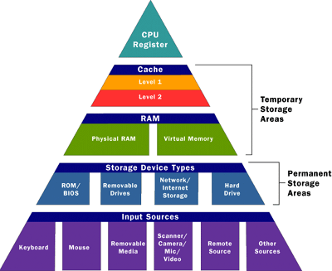
Notes:
This will be evident as we look at memory hierarchy of a general system. The memory units that are at higher level of hierarchy are close to the processing unit and suppose to be fast and less power consuming as these memory units are accessed number of times. And SRAM is the best option for building such type of memories. So decreasing the power consumed by memory will in turn decreases the total power consumed by the system and such type of memories will be suitable to use in wireless and embedded applications. This is the base for our objective.

Slide 4
Objective
Comparison of 4T and 6T SRAM cells
Design of cache memory using 4T SRAM and compare with that of 6T SRAM
Implement power reduction techniques on 4T SRAM cache
Obtain optimized design with low power and less area
Notes:
We are designing 4T and 6T SRAM cells in HSPICE and comparing cell wise parameters
We are designing cache memory using both 4T SRAM and 6T SRAM and compare functionality.
Then implement power reduction techniques on designed 4T SRAM cache and obtain optimized design

Slide 5
Literature survey
Title:
“A low power and high density cache memory on novel SRAM cell”
Description:
This paper presents a novel CMOS 4T SRAM cell
Proposed design was compared with conventional 6T SRAM.
Supply voltage is 1.2V and fabricated in a 65-nm technology

Slide 6
Title:
“Design and evaluation of high density 5T SRAM cache for advanced microprocessors”
Description:
This paper presents a comparative study of cache memory designed using 5T SRAM ad 6T SRAM.
A 128Kb memory array was implemented using 5T cell
Supply voltage is 1.8V and fabricated in a 0.18-µm technology

Slide 7
Title:
“A Low-Power Embedded SRAM for Wireless Applications”
Description:
Power reduction is obtained by the use of four new techniques
Efficient memory data bus
Exploitation of the dynamic read stability of SRAM cells
Low-swing write technique
Distributed decoder

Slide 8
Introduction
Working module for 4T SRAM cache
Pros and cons of 4T SRAM cache
Optimization of the designed cache memory
Notes:
Based on these reference papers we are taking the 4T SRAM proposed in first paper and constructing cache memory with it. At every level we are comparing the pros and cons of these designs with conventional 6T SRAM designs. 4T SRAM in less stable when compared to 6T SRAM this leads to decrease in operating frequency, we are trying to over come this by decreasing the delay of external circuitry using techniques proposed in 3rd reference paper.

Slide 9
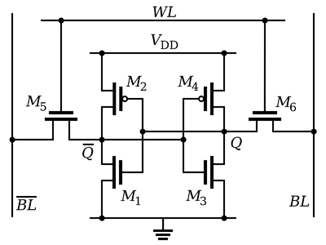
6T SRAM

Slide 10
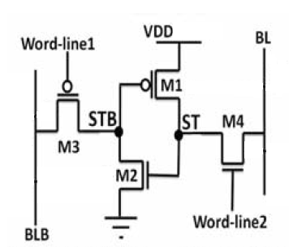
4T SRAM

